Slide 1

Data Science project: Aphasia
KB-74
Notes:
We want to start off with an example of our progress in our team, we did get some knowledge from datacamp and coursera .

Slide 2
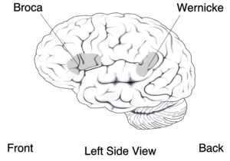
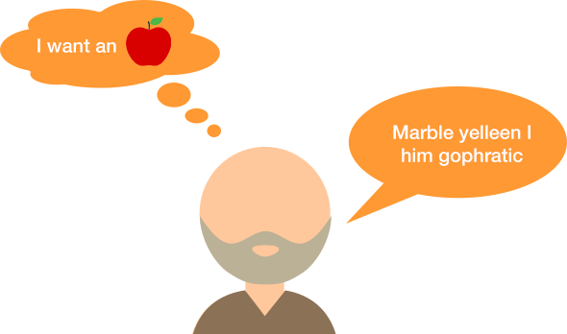
Aphasia
speech to text
Goal of the project: Create a speech to text software that can successful translate speech from aphasia patients.

Slide 3
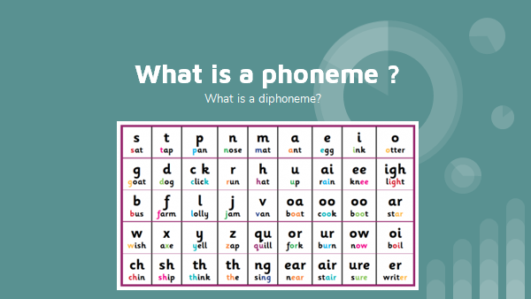

Slide 4
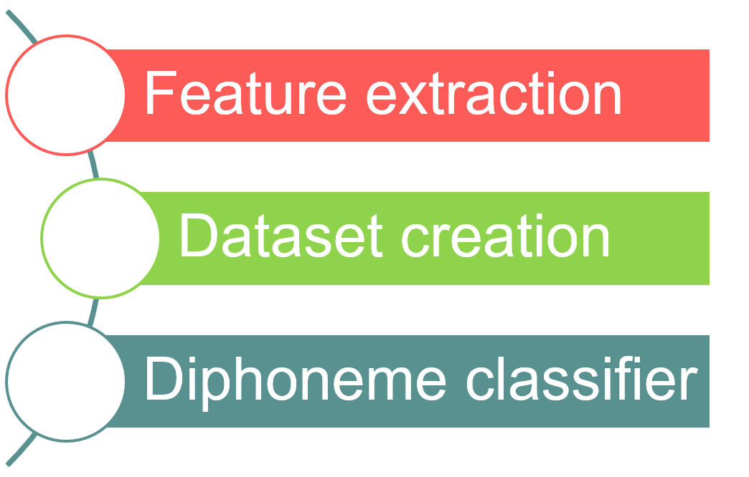
Current goal
Notes:
Feature extraction: Audiosignaal -> to features
Dataset creation to get the features in de dataset to train the diphoneme classifier

Slide 5
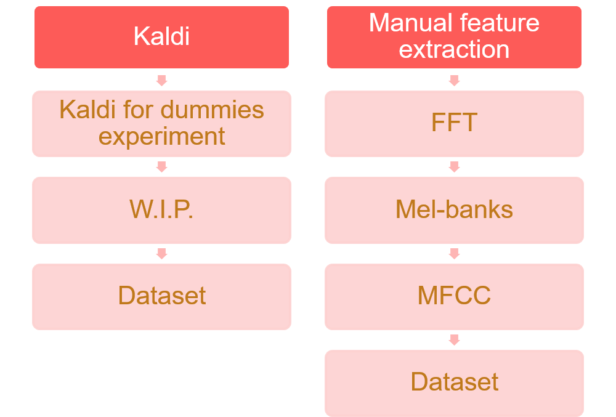

Slide 6


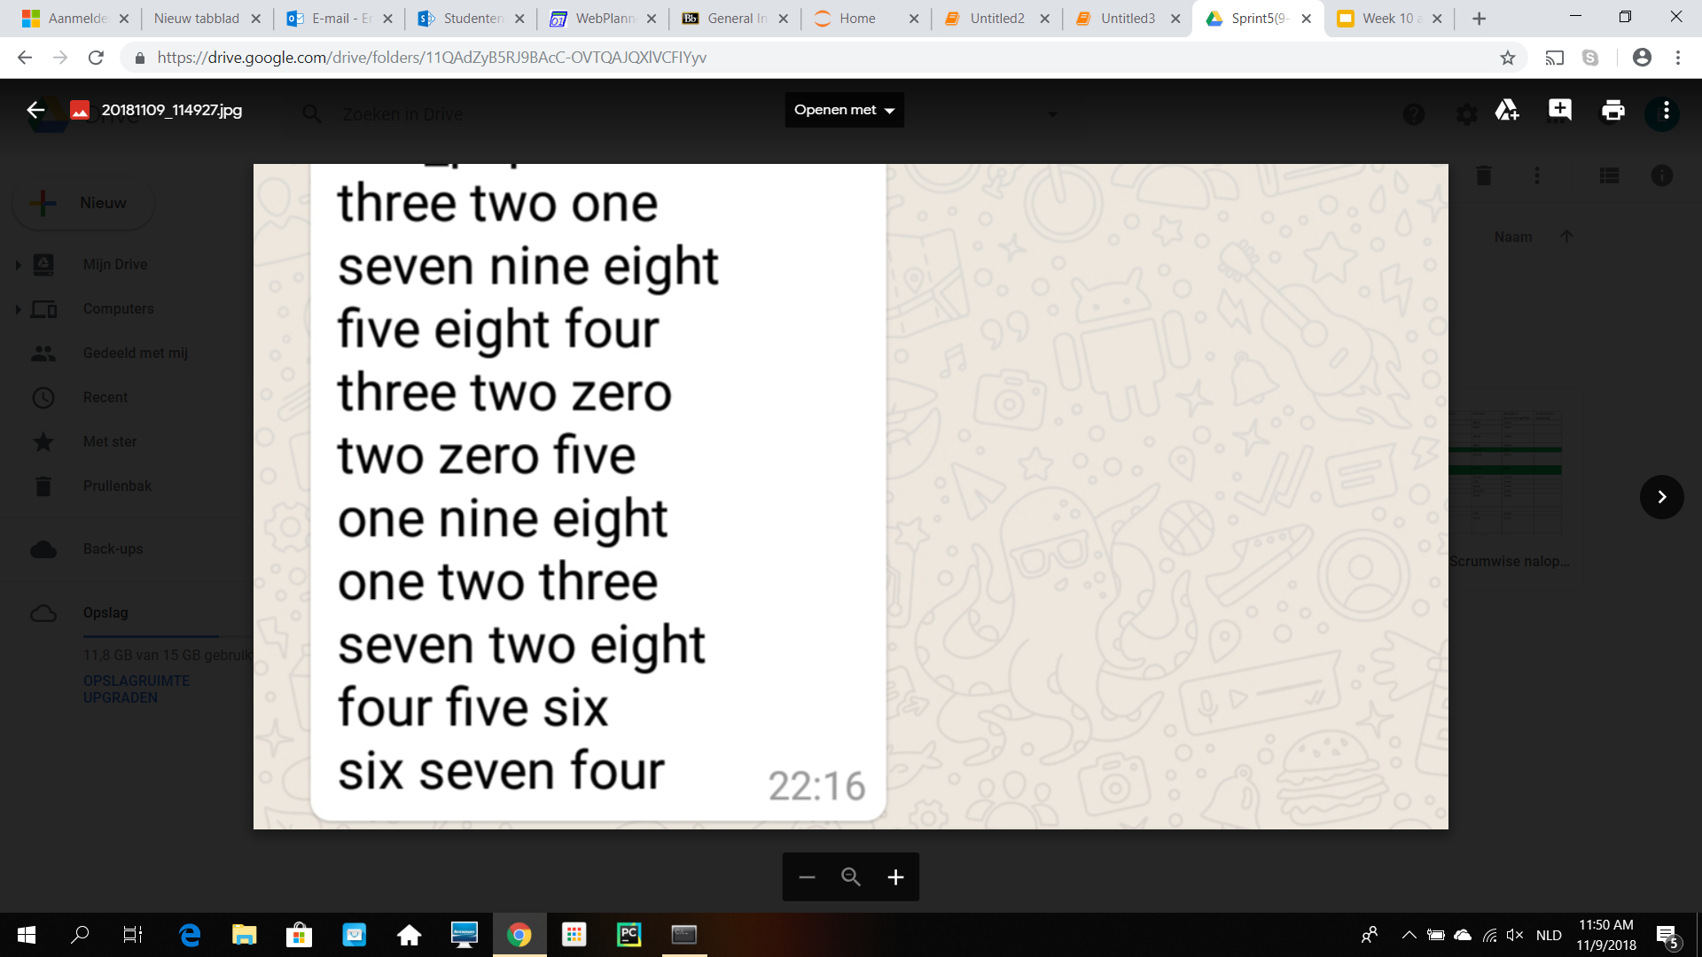
Kaldi
Experiment
Large dataset
Kaldi experiment:
Following Kaldi tutorial
Data of 10 Speakers
Record 10 sentences with 3 words
Convert audio to format for Kaldi
Facing some errors in Kaldi (W.I.P.)

Slide 8
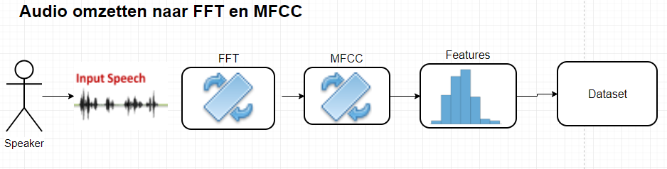
Manual feature extraction pipeline

Slide 9
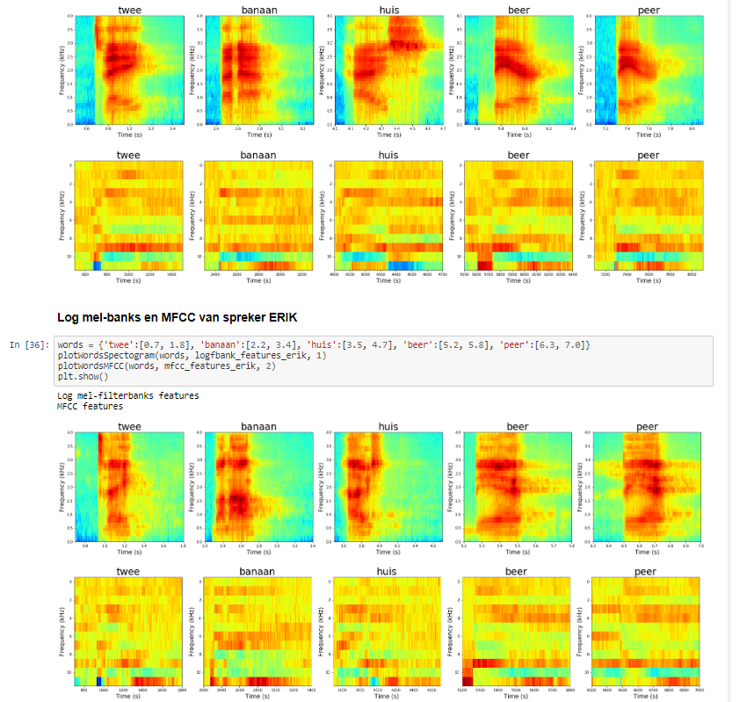
Notes:
Bovenste log mel0banks
MFFC van spreker Erik

Slide 10
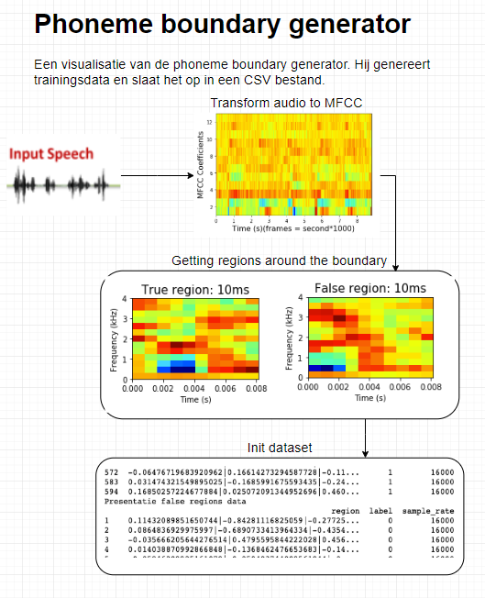
Creation of the phoneme boundary dataset.
Using FFT
MFCC features
Word Boundary
Phonemes to create diphones

Slide 11
Future work
Continue on the kaldi for dummies tutorial.
Using kaldi to create diphone classifier
Creating the classifier on small dataset

Slide 12
Questions?
Any Questions?

